Slide 1
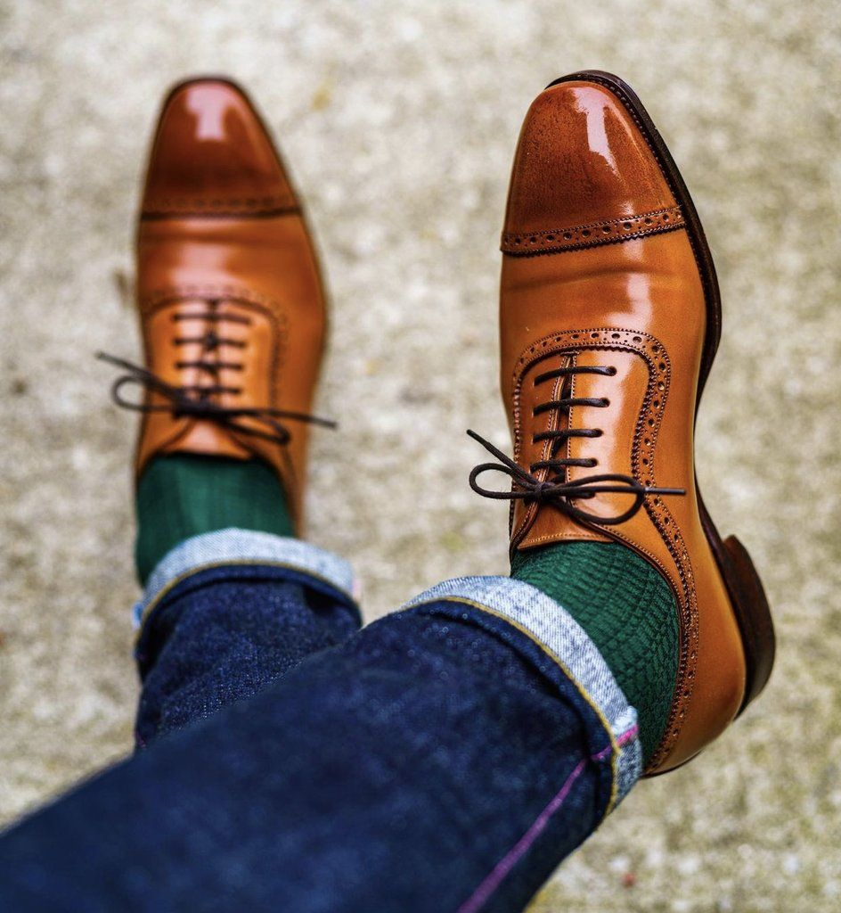
FEETS that FITS
Hand-made Leather Shoes On Steroids
Craftsman: Moses Nse-Ita

Slide 2
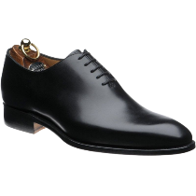
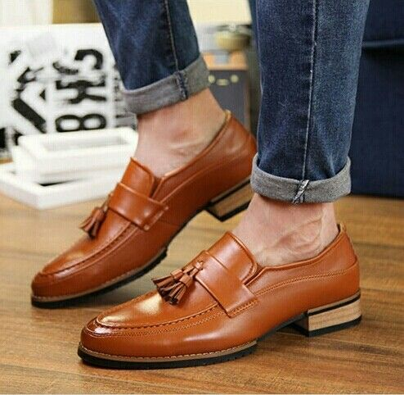
Our Essence
With FEETS that FITS all the young, old, big and small foot men get a chance of giving their feet that good, manly and luxury vibe without having to worry about foot sizes and over exaggerated prices, with just shikini money.
We hand-make quality, long lasting and comfortable leather shoes ranging from; Oxfords, Derby, Boots, Chelsea Boots, Loafers, Moccasins, Monk Strap and Boat shoes.

Slide 3
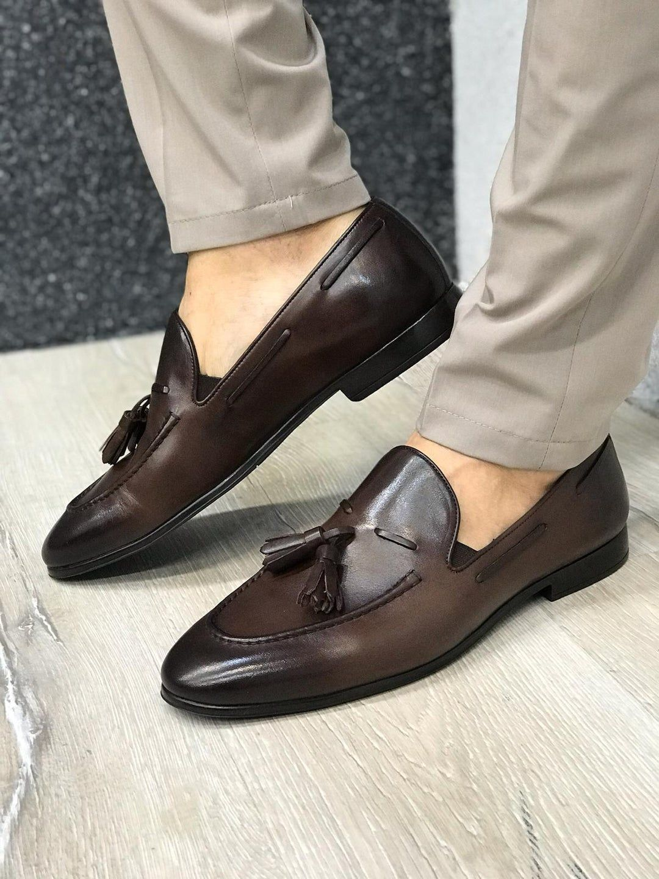
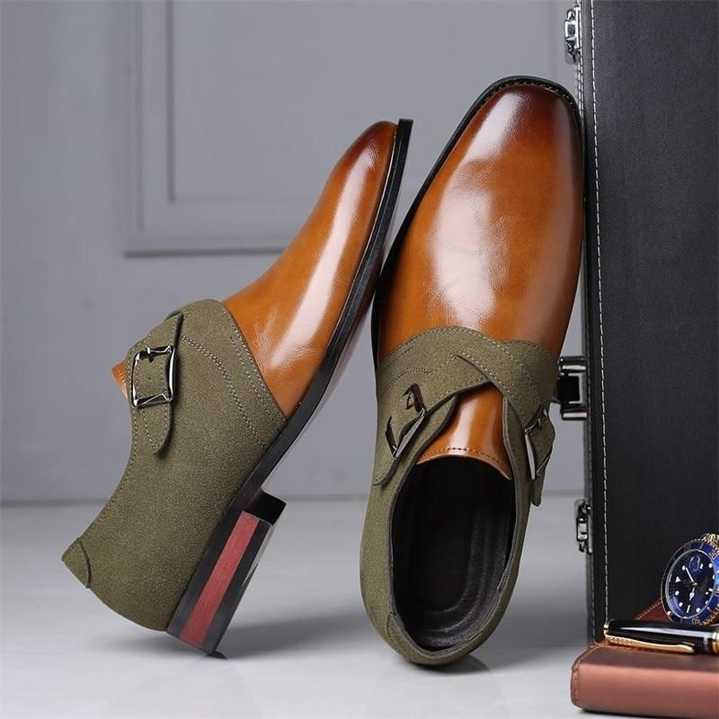
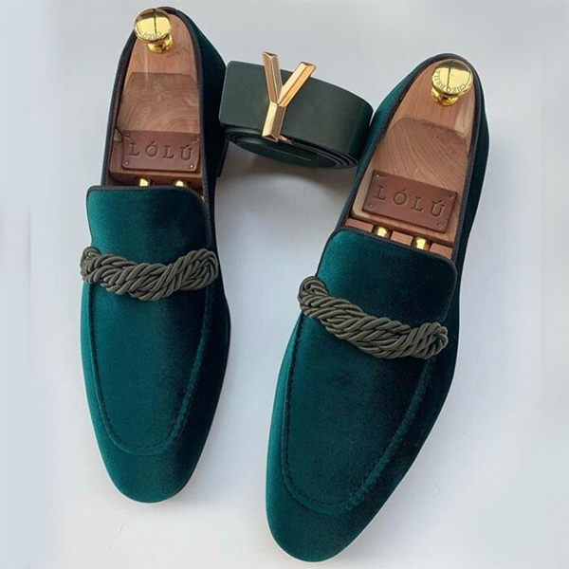
Our Pricing Table
1
Standard
2
Premium
3
Platinum
4
Super VIP

Slide 4
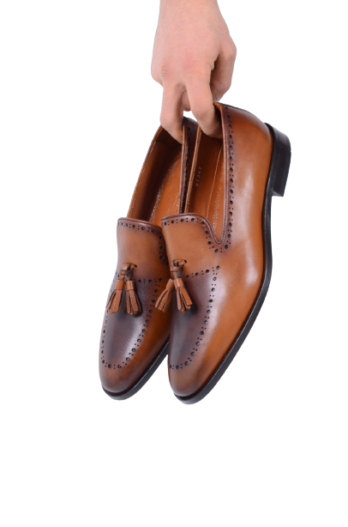



Contact Information
You can look us up via our website and contact us, we respond as swift as the wind.
Email
Website
Telephone
okonitamoseskokoette@gmail.com
https://feets-that-fits.netlify.app/
+2348078959070

Slide 5
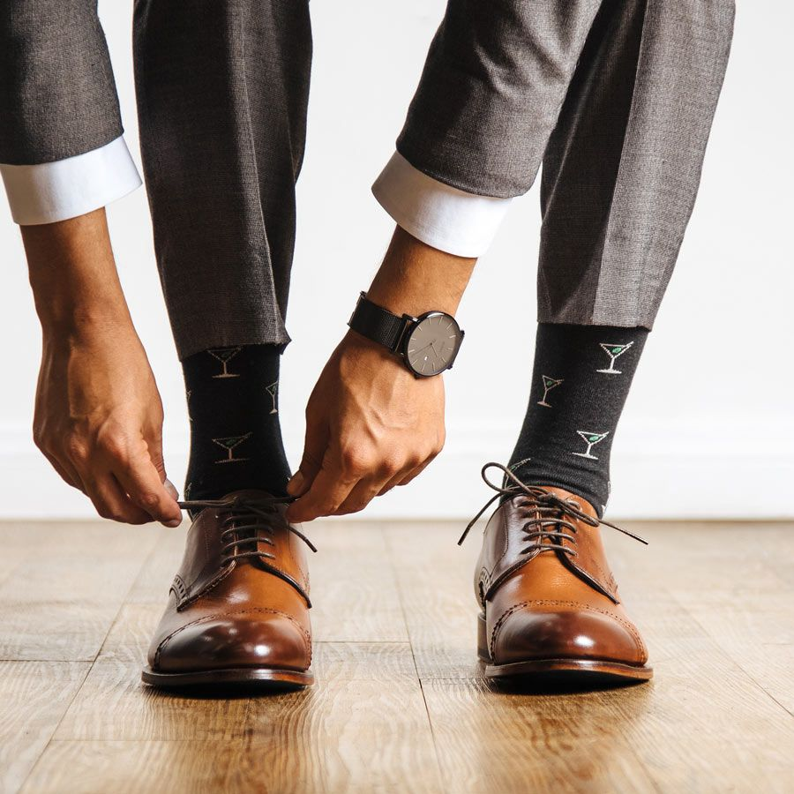
Thank You
See You Next Time

